Slide 1

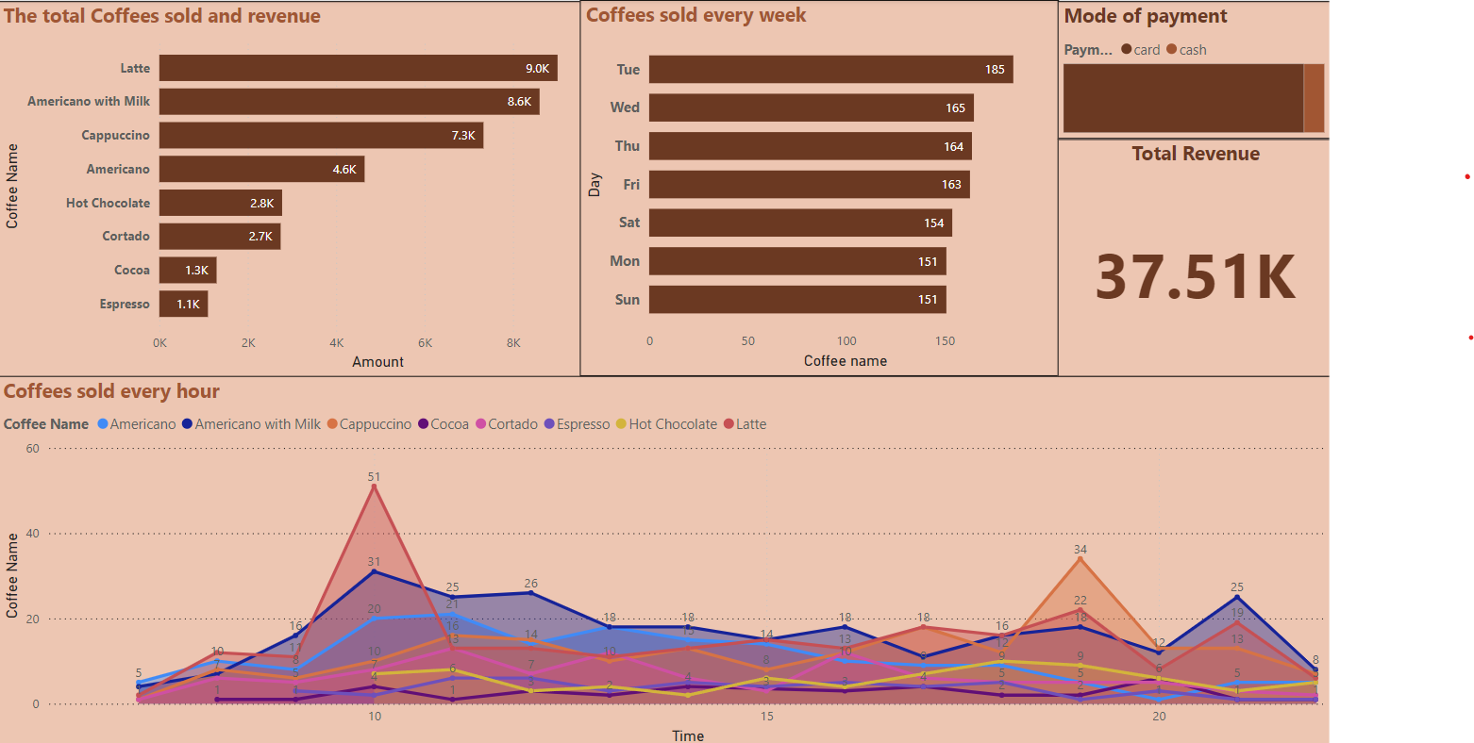
COFFEE SALES
ANALYSIS
JATHIN REDDY JAIDI

Slide 2
Introduction
The goal of this project is analyze the purchasing patterns of the customers, and their next day/week/month sales.
Need to perform time series Exploratory Data Analysis.
The dataset contains detailed records of coffee sales from a vending machine.
The dataset spans from March 2024 to Present time, capturing daily transaction data.

Slide 3
Main KPIs
(Power BI)
Total coffees sold and the revenue they generated.
Coffees sold every hour filtered by coffee type.
Coffees sold every week.
The mode of payment.
The total revenue.

Slide 5
About Tools & Work
In this analysis the tools that I’ve used are Excel and Power BI. After getting the data I loaded the data into excel spreadsheet, after that arranged the data according to my need and filtered the null values and outliers. Created new columns date, day and time.
Loaded the data to power BI, used Power query to filter hours row and created main 3 KPIs for meeting all the requirements.

Slide 6
Conclusion
In this analysis, I have uncovered valuable insights about the customer shopping patterns. The most sold item is Americano with milk followed by latte and cappuccino.
The item that generated the most revenue is latte followed by americano with milk and cappuccino.
The peak hours are 10am, 7pm, and 9pm being the hot hours, and those three coffees are sold most in these peak hours.
Tuesday has the most number of sales followed by wednesday and thursday.
The total revenue generated is $ 37.51K, card and cash are used to make payments in which card is used the most.

Slide 7
THANK YOU
Jathin Reddy Jaidi ( jatinreddy012@gmail.com )

